Slide 1
40.750 ALGORITHMIC GAME THEORY
learning dynamics in the workplace:
Who is my best collaborator?
Lai Zhangsheng
http://esd.sutd.edu.sg/phd-students/lai-zhangsheng/
Nguyen Tan Thai Hung
http://people.sutd.edu.sg/~ntthung/
Notes:
One overall picture

Slide 2
MOTIVATION: FROM OUR PASTS
There is always a game at the workplace: the workplace game.
Work alone or cooperate?
With whom?
By how much?
How to model this?

Slide 3

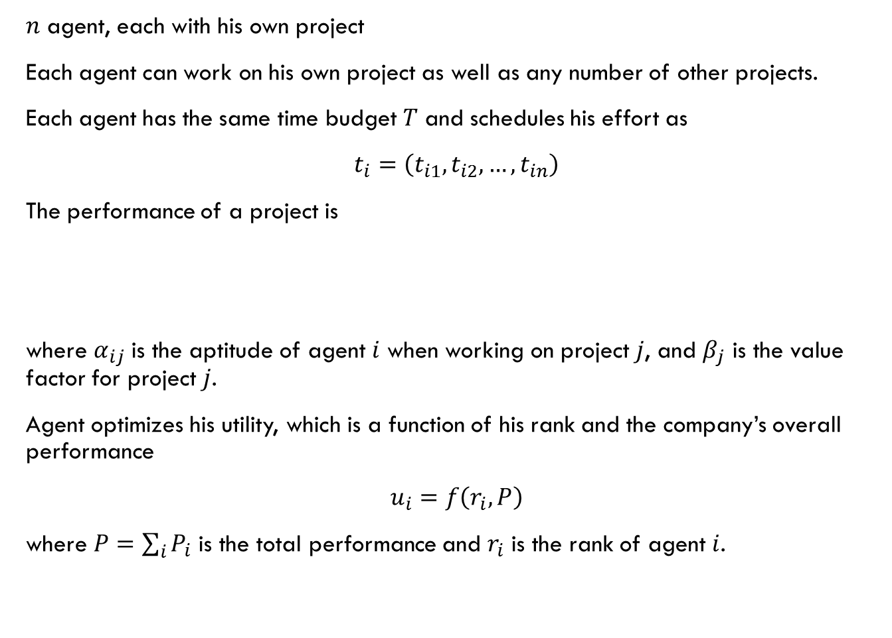
Our initial model
$n$ agent, each with his own project
Each agent can work on his own project as well as any number of other projects.
Each agent has the same time budget $T$ and schedules his effort as
$t_{i}=\left(t_{i1},t_{i2},…,t_{in}\right)$
The performance of a project is
where $α_{ij}$ is the aptitude of agent $i$ when working on project $j$, and $β_{j}$ is the value factor for project $j$.
Agent optimizes his utility, which is a function of his rank and the company’s overall performance
$u_{i}=f\left(r_{i},P\right)$
where $P=\sum_{i}{P_{i}}$ is the total performance and $r_{i}$ is the rank of agent $i$.
$$P_{j}=β_{j}\log\left(\sum_{i=1}^{n}{α_{ij}t_{ij}}\right)$$

Slide 4
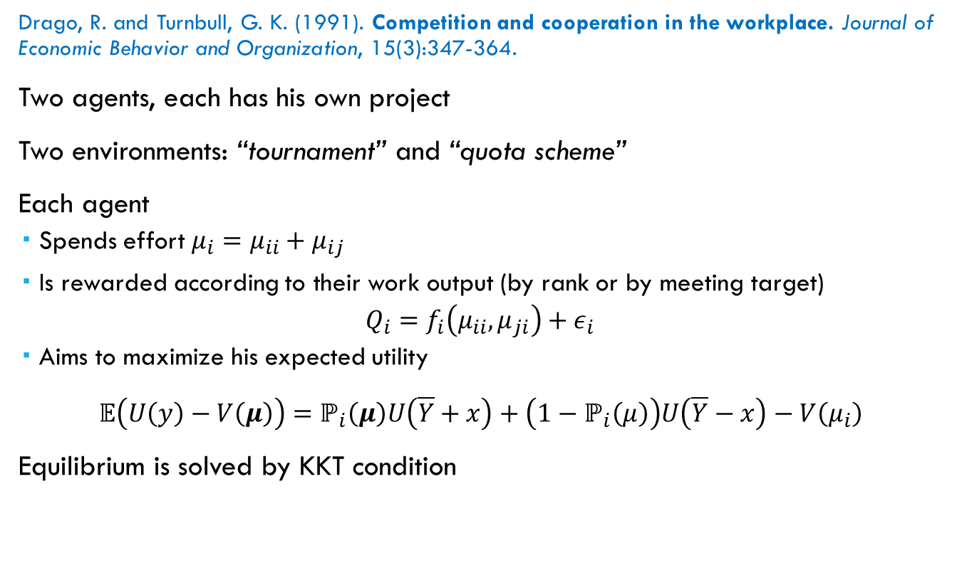
Literature: a static model
Drago, R. and Turnbull, G. K. (1991). Competition and cooperation in the workplace. Journal of Economic Behavior and Organization, 15(3):347-364.
Two agents, each has his own project
Two environments: “tournament” and “quota scheme”
Each agent
Spends effort $μ_{i}=μ_{ii}+μ_{ij}$
Is rewarded according to their work output (by rank or by meeting target)
$Q_{i}=f_{i}\left(μ_{ii},μ_{ji}\right)+ε_{i}$
Aims to maximize his expected utility
$𝔼\left(U\left(y\right)−V\left(μ\right)\right)=ℙ_{i}\left(μ\right)U\left(\overline{Y}+x\right)+\left(1−ℙ_{i}\left(μ\right)\right)U\left(\overline{Y}−x\right)−V\left(μ_{i}\right)$
Equilibrium is solved by KKT condition

Slide 5
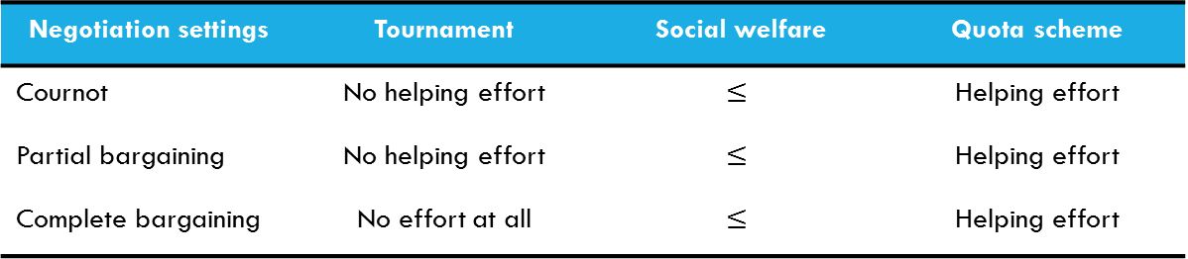
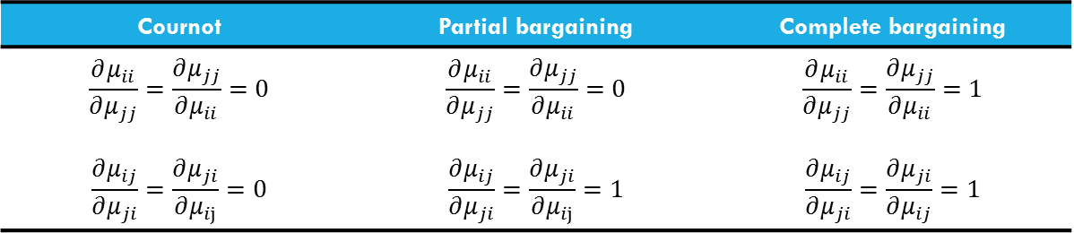
Literature: a static model
Negotiation settings
Cournot | Partial bargaining | Complete bargaining
$$\frac{∂μ_{ii}}{∂μ_{jj}}=\frac{∂μ_{jj}}{∂μ_{ii}}=0$$ $$\frac{∂μ_{ij}}{∂μ_{ji}}=\frac{∂μ_{ji}}{∂μ_{ij}}=0$$ | $$\frac{∂μ_{ii}}{∂μ_{jj}}=\frac{∂μ_{jj}}{∂μ_{ii}}=0$$ $$\frac{∂μ_{ij}}{∂μ_{ji}}=\frac{∂μ_{ji}}{∂μ_{ij}}=1$$ | $$\frac{∂μ_{ii}}{∂μ_{jj}}=\frac{∂μ_{jj}}{∂μ_{ii}}=1$$ $$\frac{∂μ_{ij}}{∂μ_{ji}}=\frac{∂μ_{ji}}{∂μ_{ij}}=1$$
Findings
Negotiation settings | Tournament | Social welfare | Quota scheme
Cournot | No helping effort | $$≤$$ | Helping effort
Partial bargaining | No helping effort | $$≤$$ | Helping effort
Complete bargaining | No effort at all | $$≤$$ | Helping effort

Slide 6
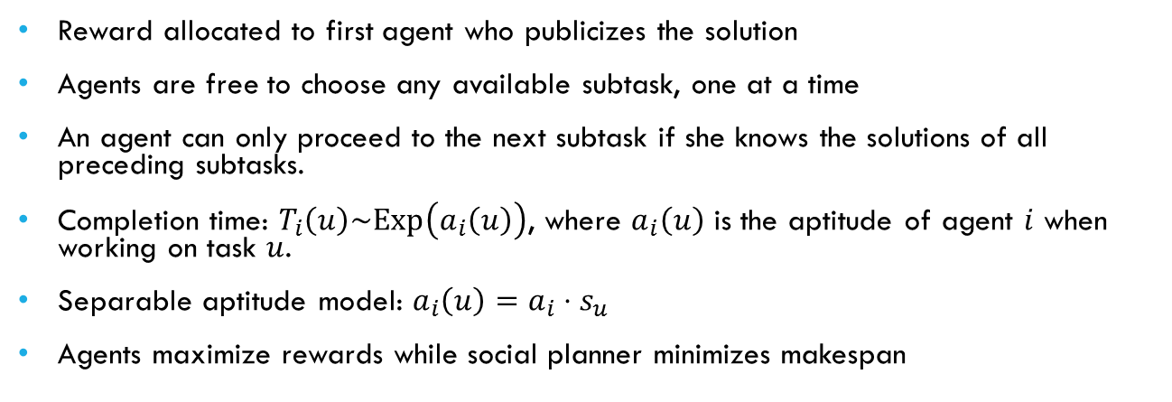
literature: A sequential model
Banerjee, S., Goel, A., and Kollagunta Krishnaswamy, A. (2014). Re-incentivizing discovery. In Proceedings of the fifteenth ACM conference on Economics and computation - EC '14
Linear subtask network
Acyclic subtask network
Reward allocated to first agent who publicizes the solution
Agents are free to choose any available subtask, one at a time
An agent can only proceed to the next subtask if she knows the solutions of all preceding subtasks.
Completion time: $T_{i}\left(u\right)\sim Exp\left(a_{i}\left(u\right)\right)$, where $a_{i}\left(u\right)$ is the aptitude of agent $i$ when working on task $u$.
Separable aptitude model: $a_{i}\left(u\right)=a_{i}⋅s_{u}$
Agents maximize rewards while social planner minimizes makespan

Slide 7
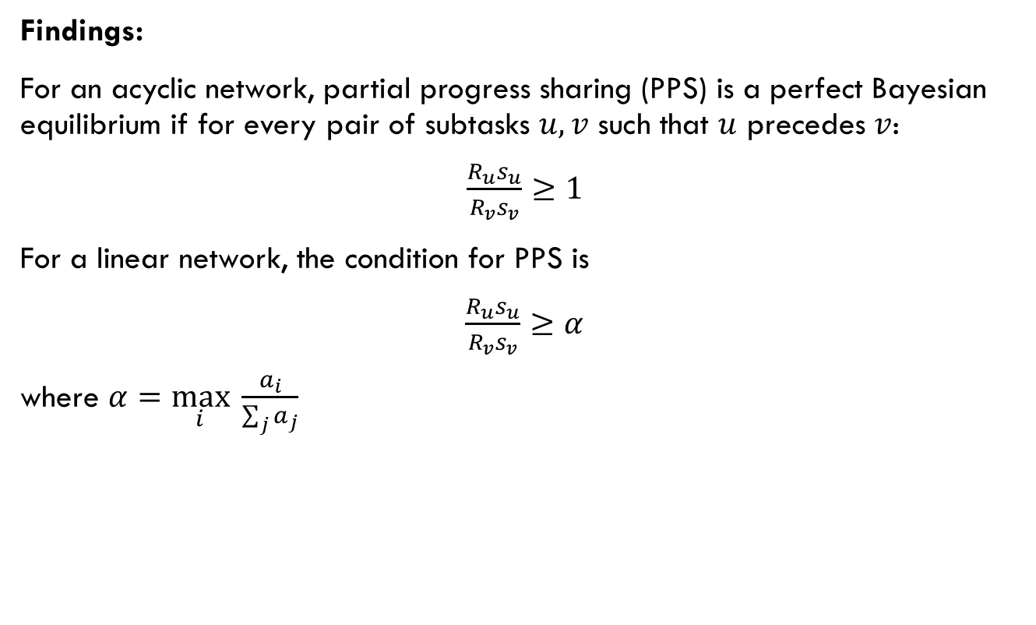
Literature: a sequential model
Findings:
For an acyclic network, partial progress sharing (PPS) is a perfect Bayesian equilibrium if for every pair of subtasks $u,v$ such that $u$ precedes $v$:
$\frac{R_{u}s_{u}}{R_{v}s_{v}}≥1$
For a linear network, the condition for PPS is
$\frac{R_{u}s_{u}}{R_{v}s_{v}}≥α$
where $α=\max_{i} \frac{a_{i}}{\sum_{j}{a_{j}}}$

Slide 8
How do we go from here?
Drago and Turnbull (1991)
Static model, but workplace is dynamic
Banerjee et al. (2014)
Sequential model
Perfect information (not realistic)
Separable aptitude
Cooperation is only in information sharing. Agents still work individually.
Project ownership
At each time step, any agent can choose any one available project
Some restrictions on the utility function
Our goals:
Imperfect information: agents have to learn
Non-static: system changes as a result of learning
Mechanism design: help agents learn the right thing
Learning dynamics (hopefully no-regrets)!

Slide 9
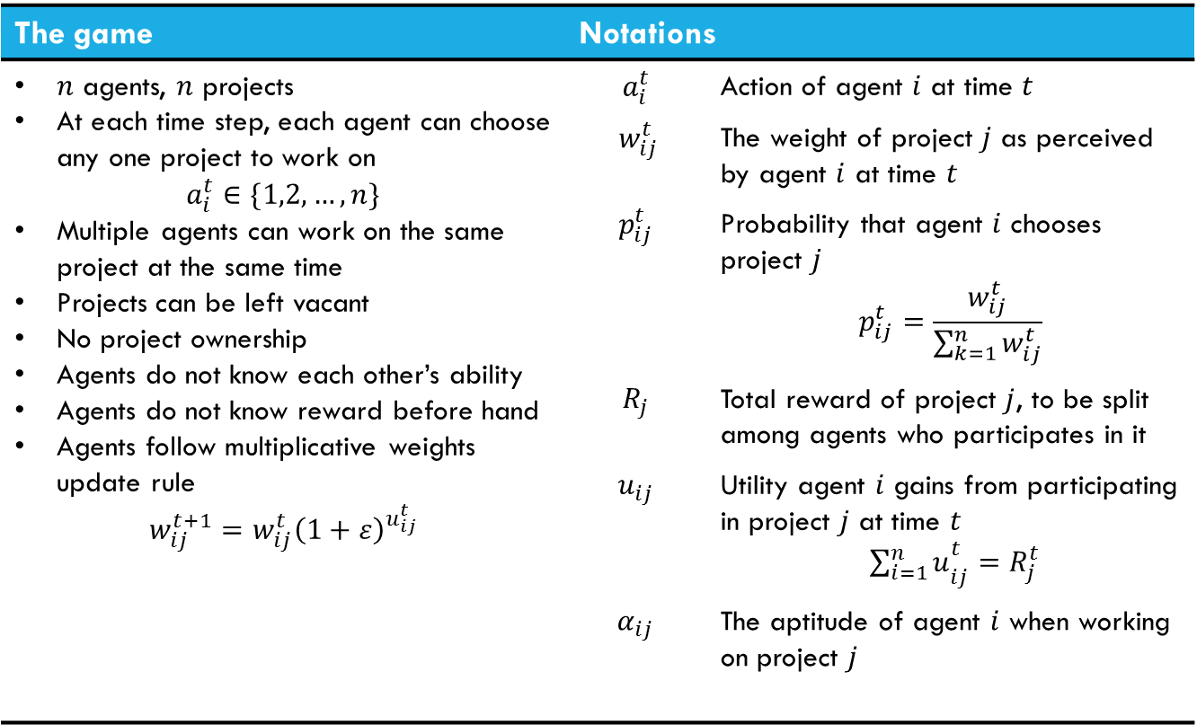
The Model
The game | Notations
$n$ agents, $n$ projects At each time step, each agent can choose any one project to work on $$a_{i}^{t}∈\{1,2,…,n\}$$ Multiple agents can work on the same project at the same time Projects can be left vacant No project ownership Agents do not know each other’s ability Agents do not know reward before hand Agents follow multiplicative weights update rule $$w_{ij}^{t+1}={w_{ij}^{t}\left(1+ε\right)}^{u_{ij}^{t}}$$ | $$a_{i}^{t}$$ | Action of agent $i$ at time $t$
 | $$w_{ij}^{t}$$ | The weight of project $j$ as perceived by agent $i$ at time $t$
 | $$p_{ij}^{t}$$ | Probability that agent $i$ chooses project $j$ $$p_{ij}^{t}=\frac{w_{ij}^{t}}{\sum_{k=1}^{n}{w_{ij}^{t}}}$$
 | $$R_{j}$$ | Total reward of project $j$, to be split among agents who participates in it
 | $$u_{ij}$$ | Utility agent $i$ gains from participating in project $j$ at time $t$ ${\sum_{i=1}^{n}{u}}_{ij}^{t}=R_{j}^{t}$
 | $$α_{ij}$$ | The aptitude of agent $i$ when working on project $j$
Notes:
The reward of a project (as a result of its performance) is a monotonic concave function with respect to the total aptitude of its participants
E.g. the logarithm function
$$R_{j}^{t}=log\left(1+\sum_{i=1}^{n}{α_{ij}{\text{𝟙}}_{\left\{a_{i}^{t}=j\right\}}}\right)$$

Slide 10
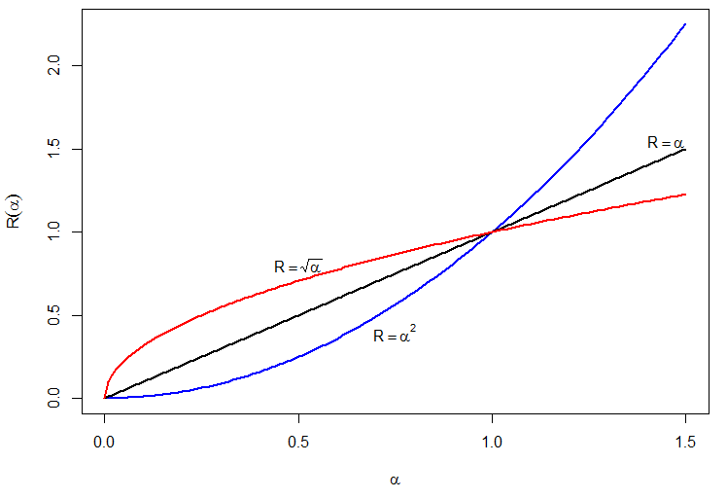
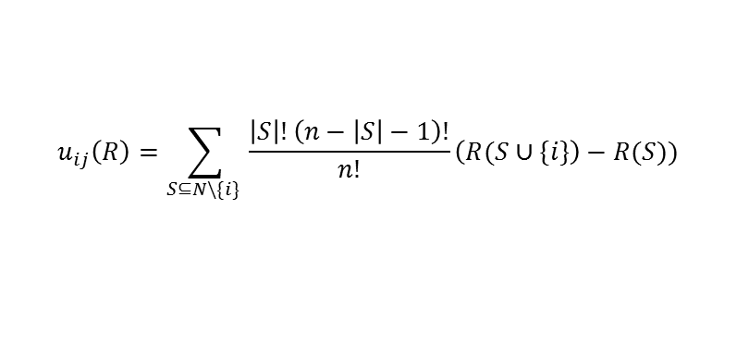
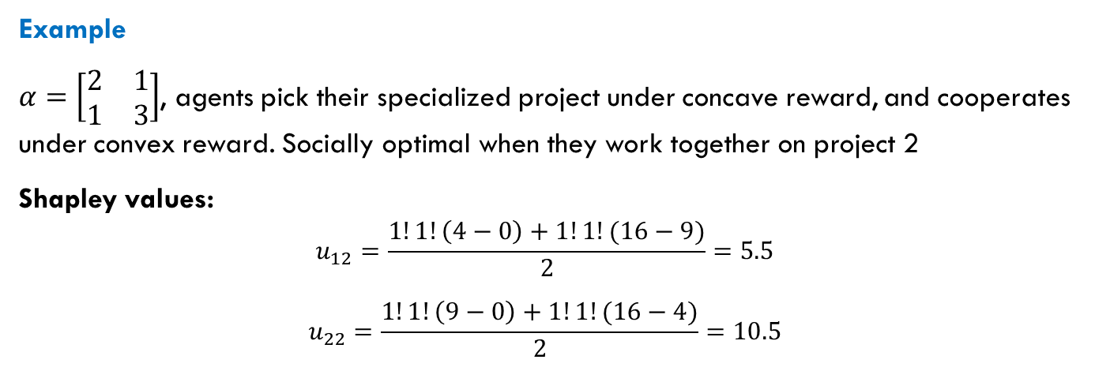
The setting (environment)
The setting is an important modelling choice.
Reward form and structure may induce or prevent cooperation.
Profit sharing arrangement may play a role.
E.g. Shapley value
$$u_{ij}\left(R\right)=\sum_{S⊆N\backslash \{i\} }{\frac{\left|S\right|!\left(n−\left|S\right|−1\right)!}{n!}\left(R(S∪\{i\}\right)−R(S))}$$
Example
$α=\left[\begin{matrix}2 & 1 \\ 1 & 3\end{matrix}\right]$, agents pick their specialized project under concave reward, and cooperates under convex reward. Socially optimal when they work together on project 2
Shapley values:
$$u_{12}=\frac{1!1!\left(4−0\right)+1!1!(16−9)}{2}=5.5$$
$$u_{22}=\frac{1!1!\left(9−0\right)+1!1!(16−4)}{2}=10.5$$

Slide 11
Simulation results
Two-agent games
Equal share of reward

Slide 12
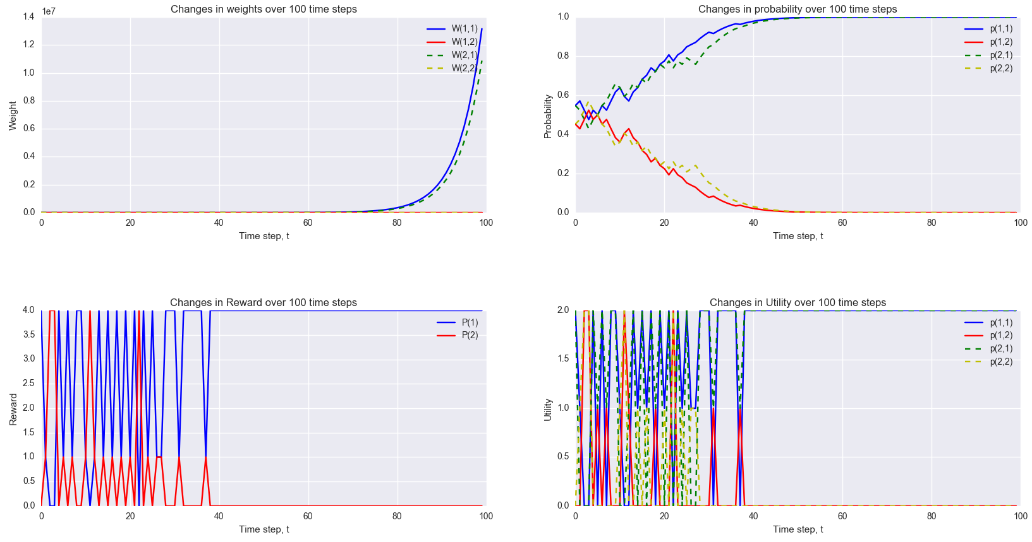
Uniform aptitude
Quadratic reward

Slide 13
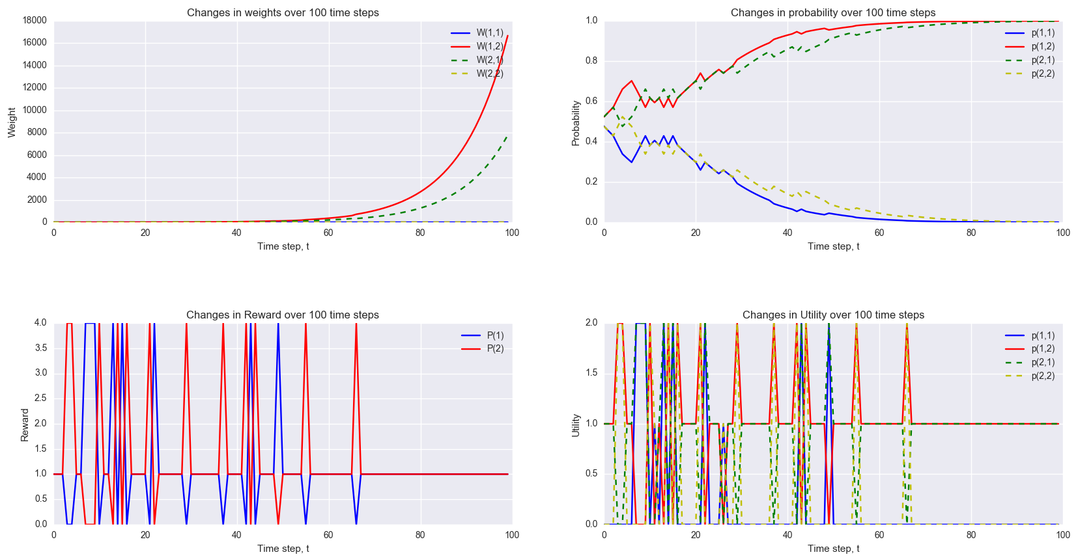
uniform aptitude
Quadratic reward
Agents can learn wrongly

Slide 14
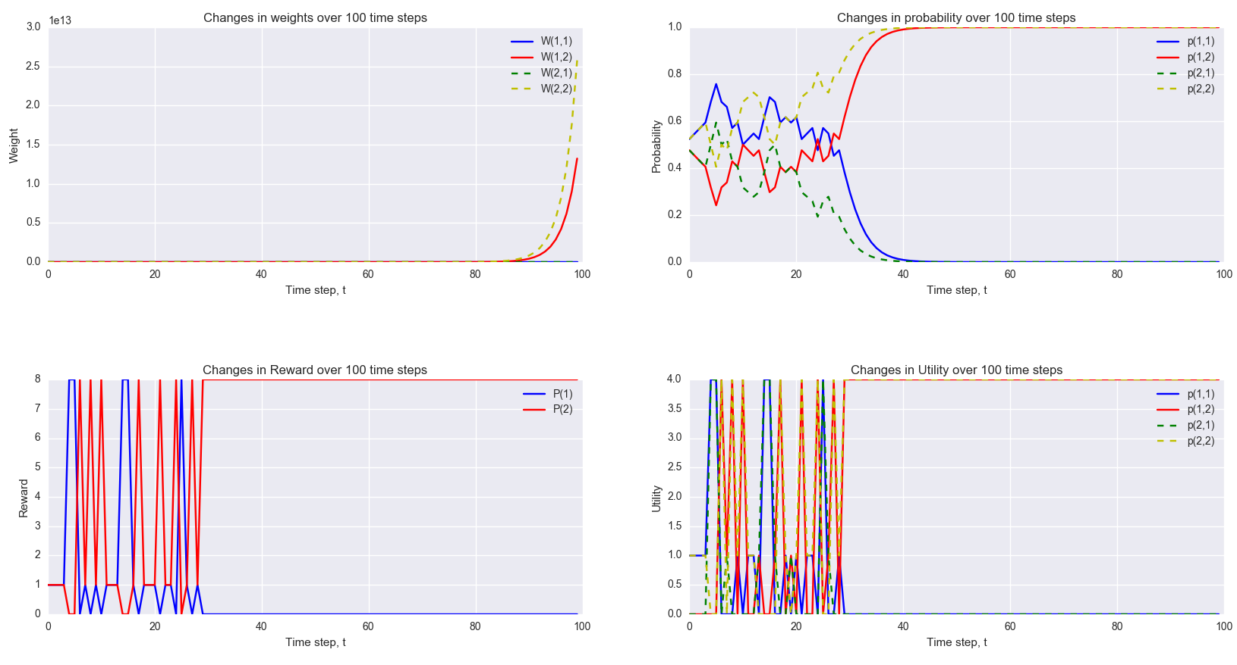
uniform aptitude
Cubic reward
Agents can learn wrongly, but the chances of turning back are higher

Slide 15
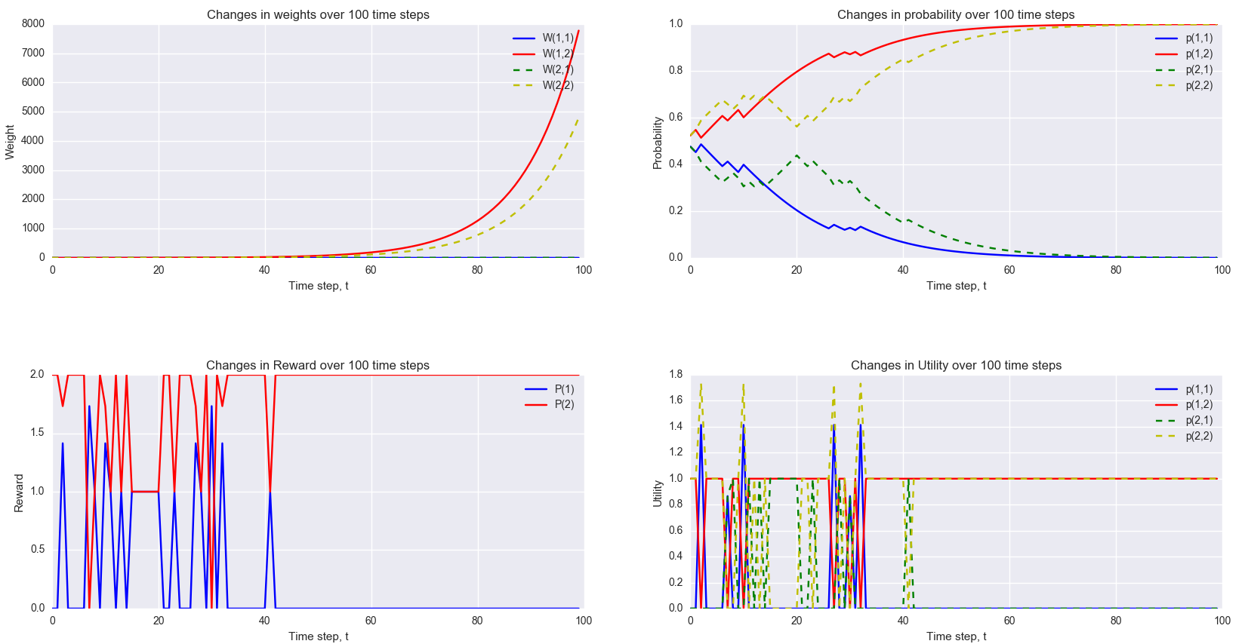
uniform aptitude
Square-rooted reward
Agents work alone now

Slide 16
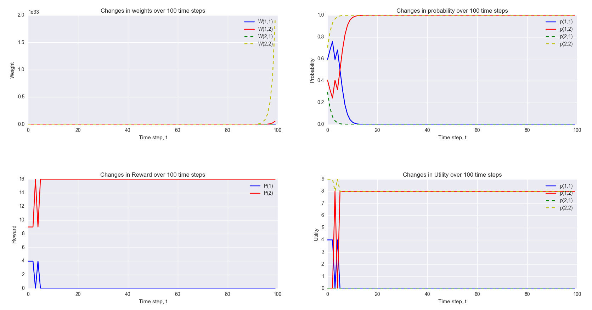
Specialized project
Convex reward
The more lucrative project is chosen
Note: player 1 is free-riding on player 2. Shapley would have been fairer.

Slide 17
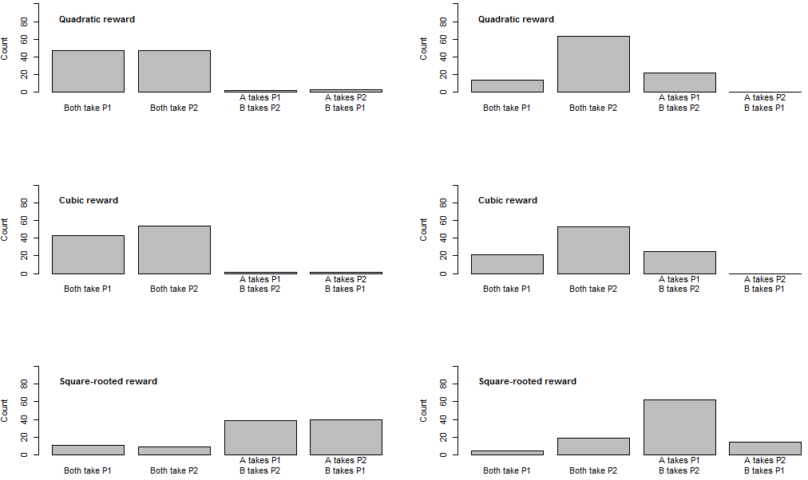
What does convergence look like?
Uniform aptitude
Specialized aptitude

Slide 18

Discussion
Agents learn the right action most of the time.
Actually, it’s multiplicative weights update, but not strictly no-regret dynamics
Cost / utility vector here is not “what I would have got if I chose that one”
Shapley price is not applicable when a sub-optimal action is chosen.
Hard to code in $n>2$ case (lots of technicalities that are language-specific).

Slide 19

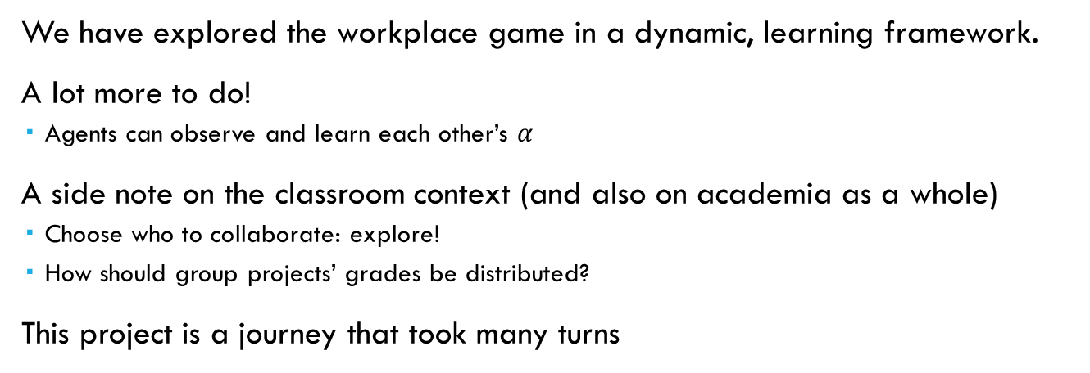
Summary and conclusions
We have explored the workplace game in a dynamic, learning framework.
A lot more to do!
Agents can observe and learn each other’s $α$
A side note on the classroom context (and also on academia as a whole)
Choose who to collaborate: explore!
How should group projects’ grades be distributed?
This project is a journey that took many turns
If you see us collaborate in the future, know that this works!

